Slide 2
Plintron GTACT Portal

Slide 3
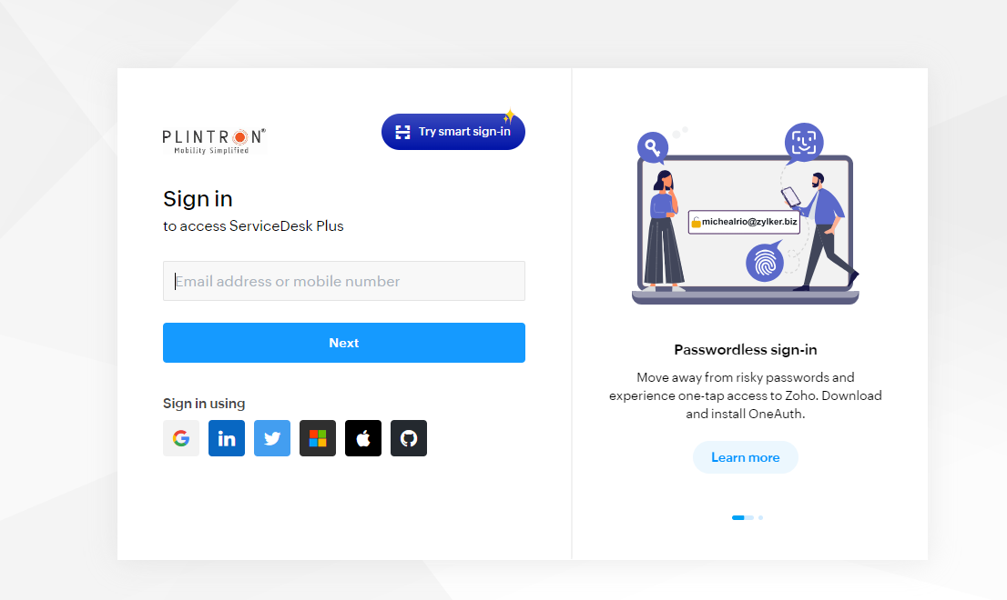
Login Page of Gtac Portal
Plintron Portal is used to raise the Ticket with Plintron/BSNL team for ESIM dual profile cases
1
Login Page

Slide 4
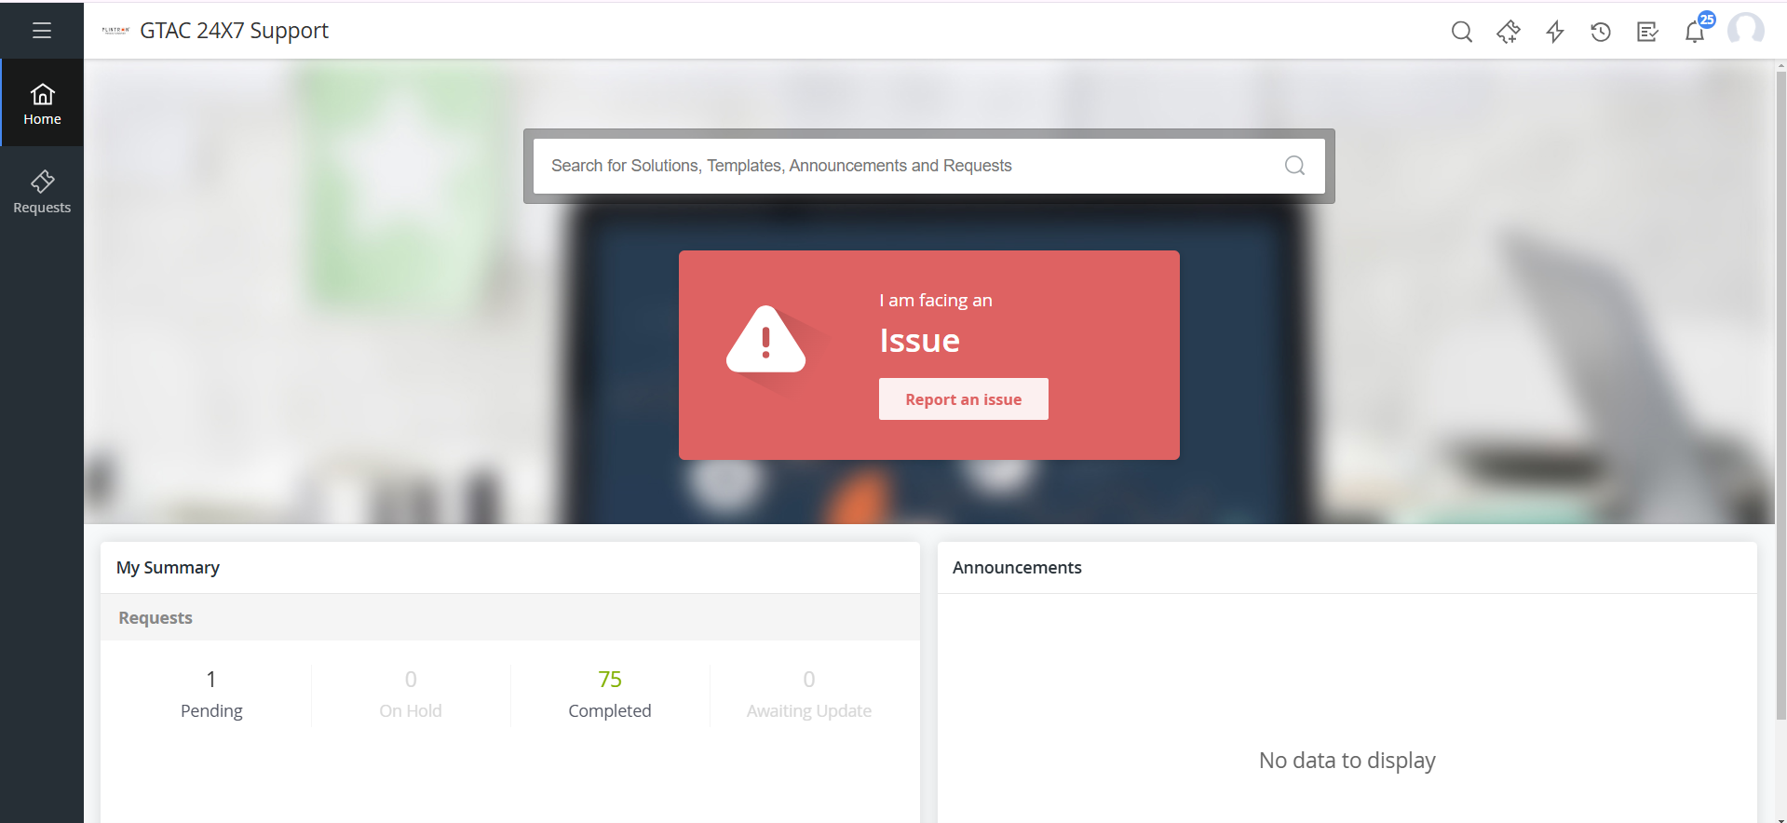
Home Page
Click on I am facing an Issue- Report Issue

Slide 5
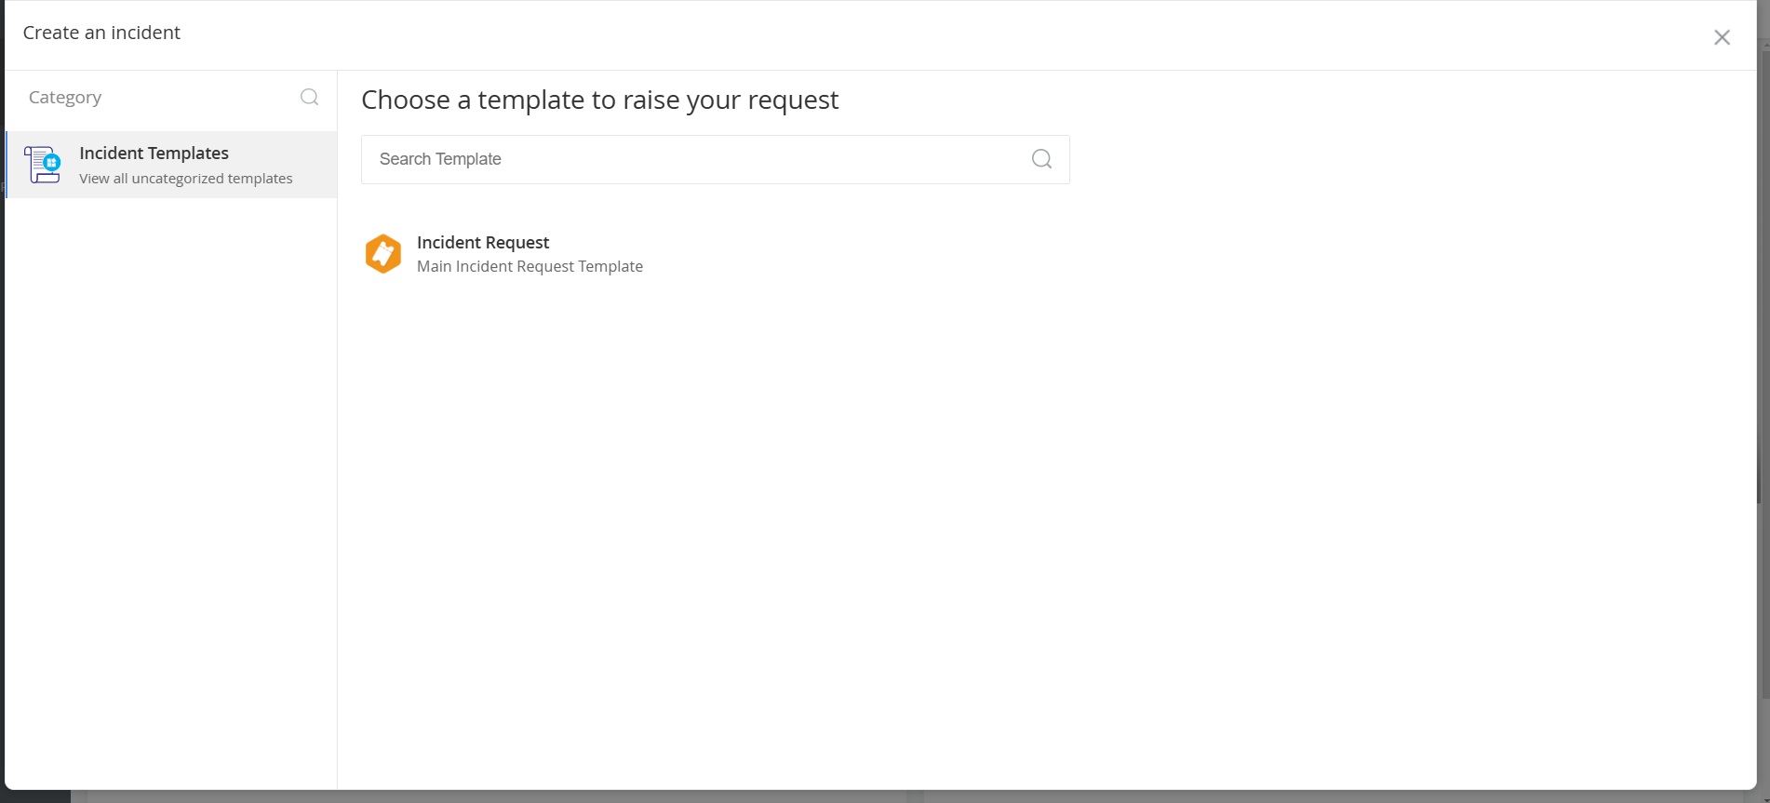
Incident Management
1
On Incident Request you can raise the issue

Slide 6
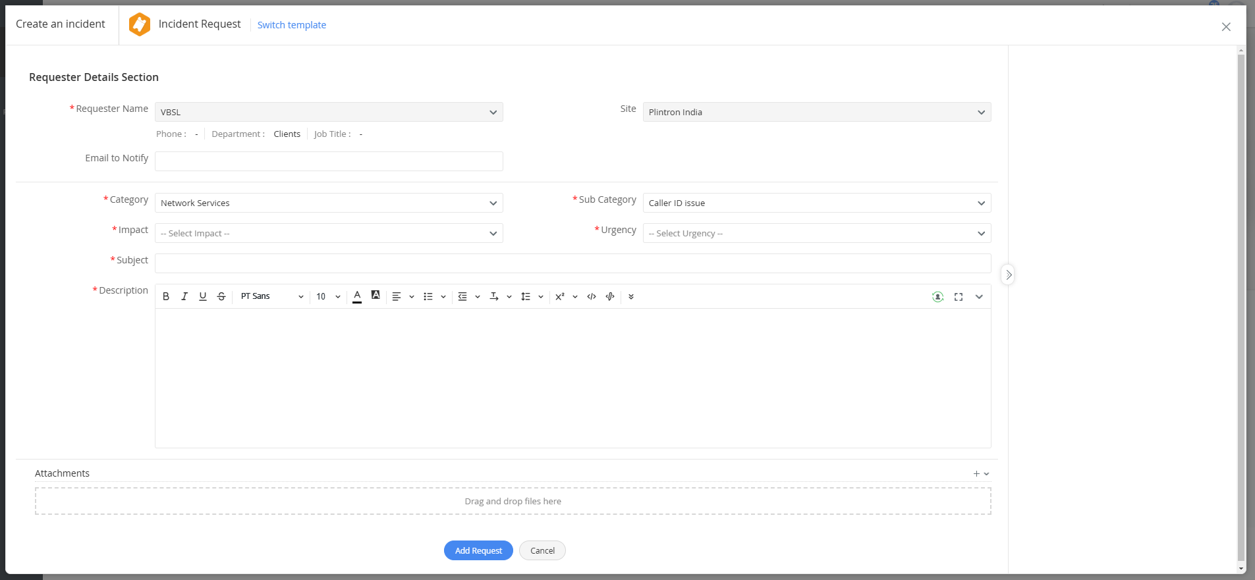
Ticket Booking Interface
1
This is the incident request form

Slide 7
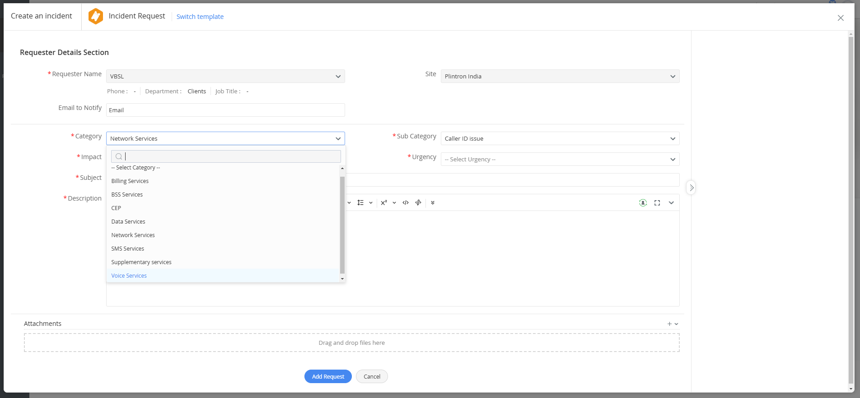
Selecting the Category- Data services
Choose the issue category to raise the ticket
1

Slide 8
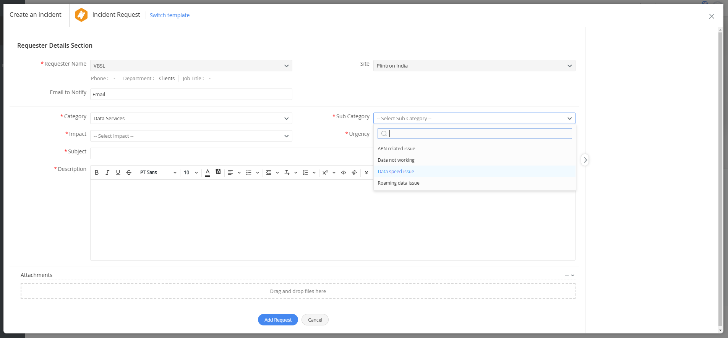
Selecting the Sub Category- Data not working/ Data Speed issue
Select the sub-category to for the reported issue
1

Slide 9
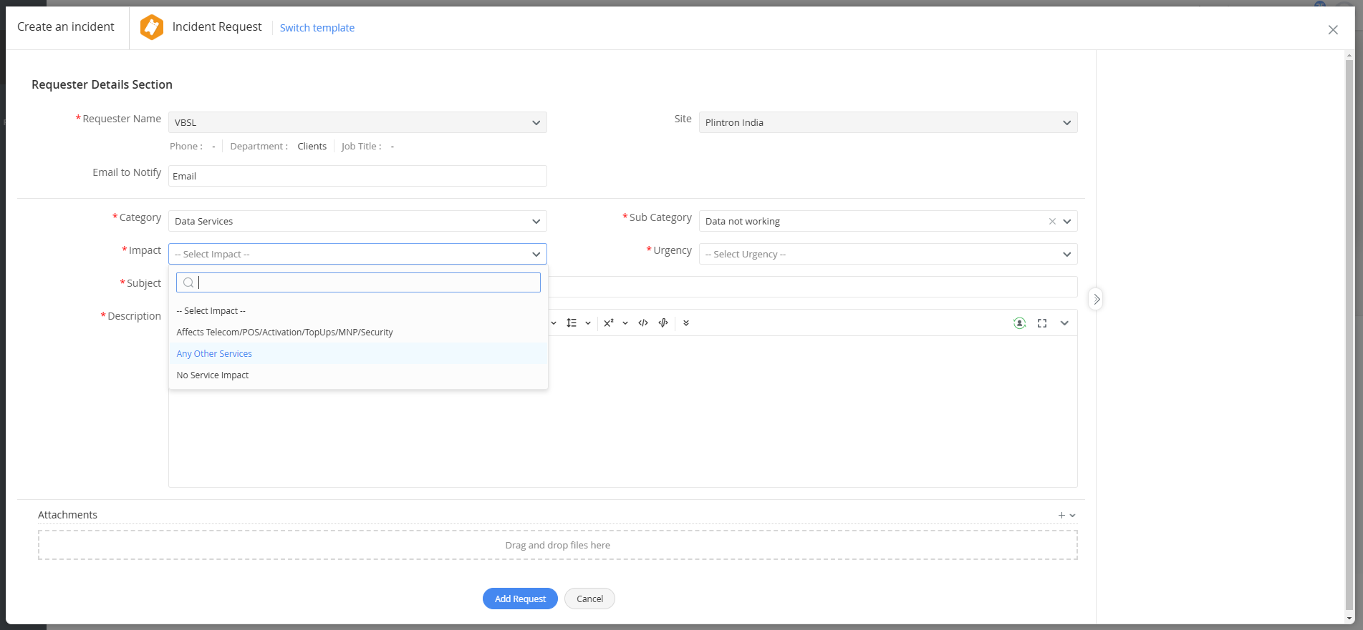
Impact
Selecting the Subject- No Impact Service/ Any Other service
1

Slide 10
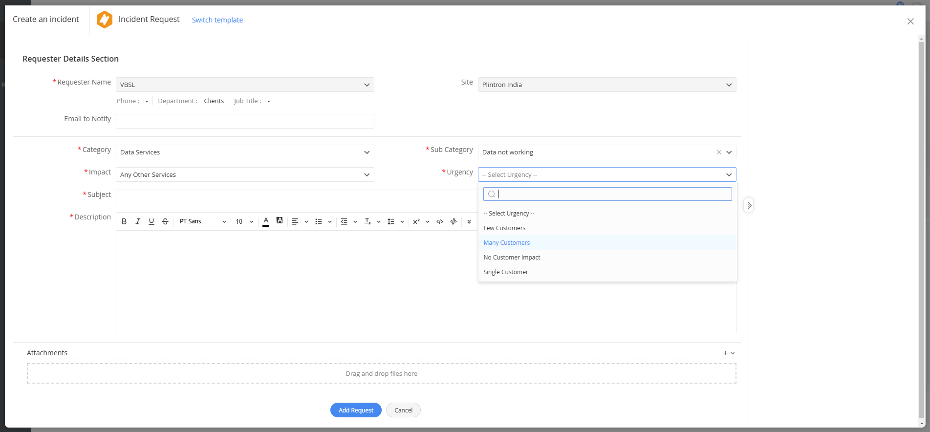
Urgeny
Selecting the Urgency- Single Customer/ Many Customers
1

Slide 11
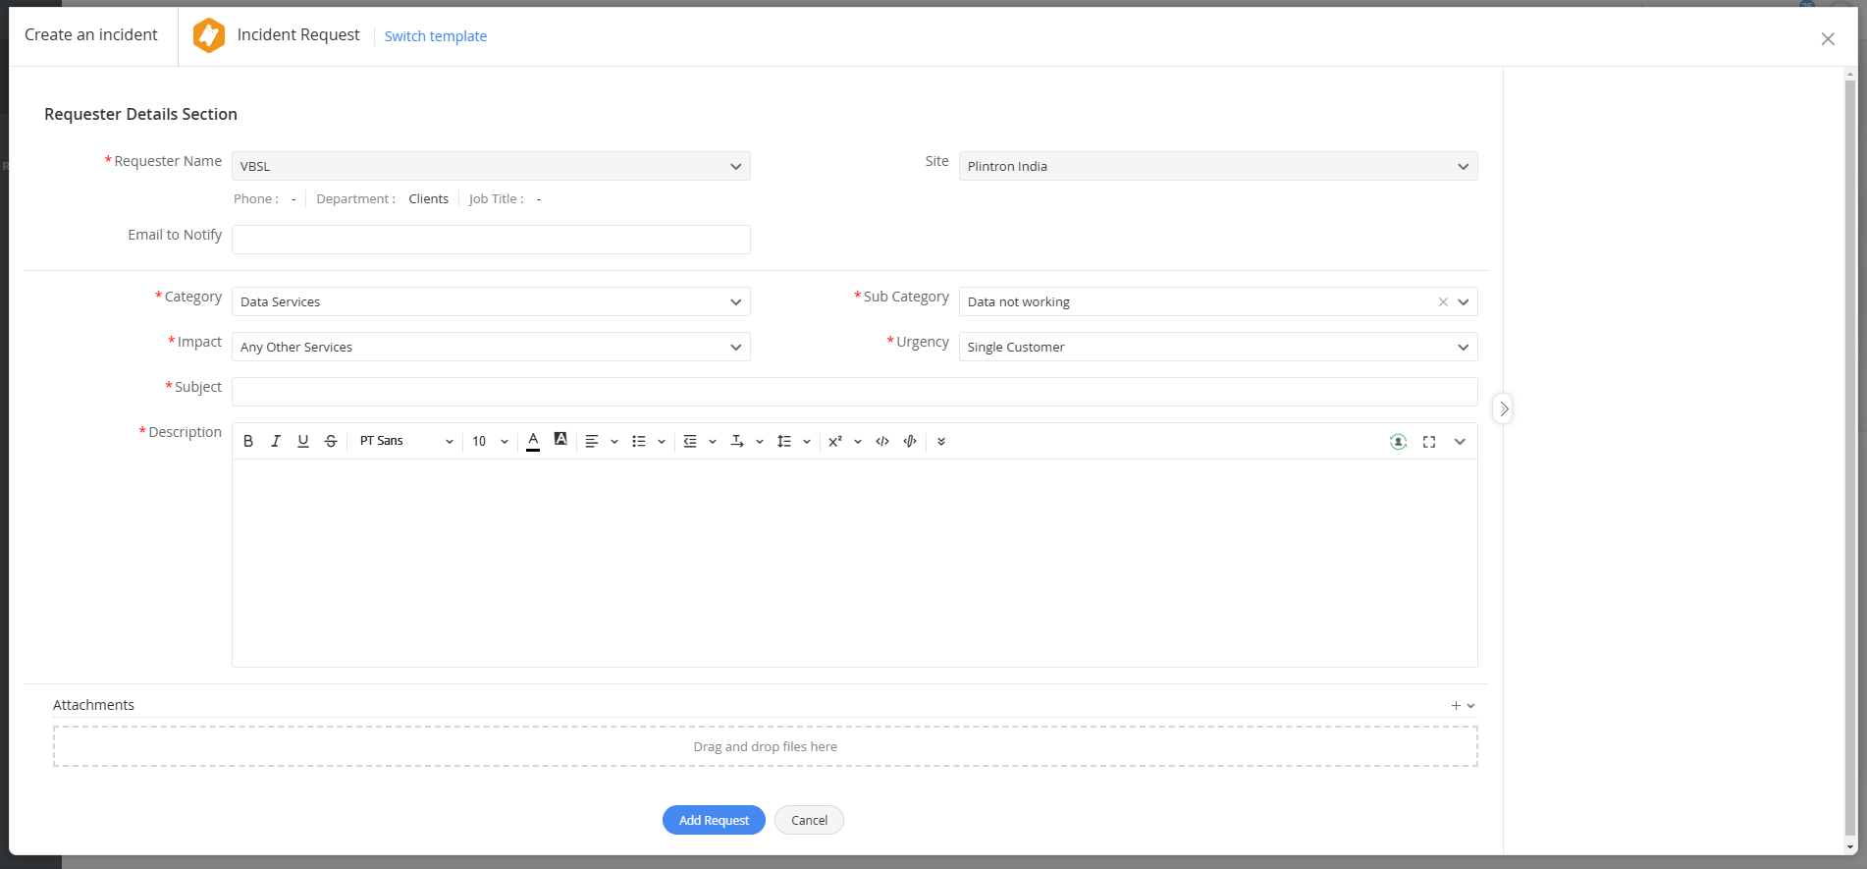
Subject Line- Data not working for BSNL number/ Latching Issue || TT ID(EN_IOT_...)
Mention the exact issue with the BSNL number.
To know the BSNL number you can check the number in SCRM and CMP portals.
In SCRM you can check in e-sim profile and get the BSNL number details.
In the CMP Portal, the second highlighted numbers are BSNL numbers please use this reference while raising the TT
1

Slide 12
Thank you !

